Slide 1
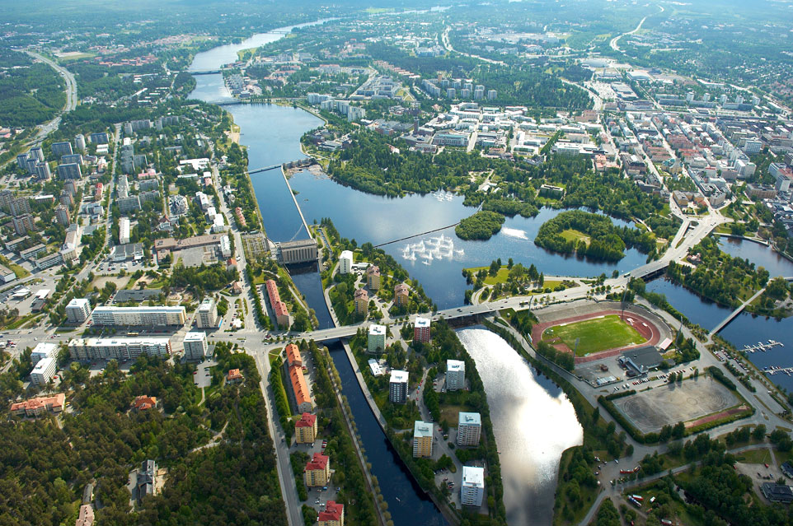
Digitale mestere fra de finske skoger –Oulu og Hightech Maja Terning, BusinessOulu

Slide 2
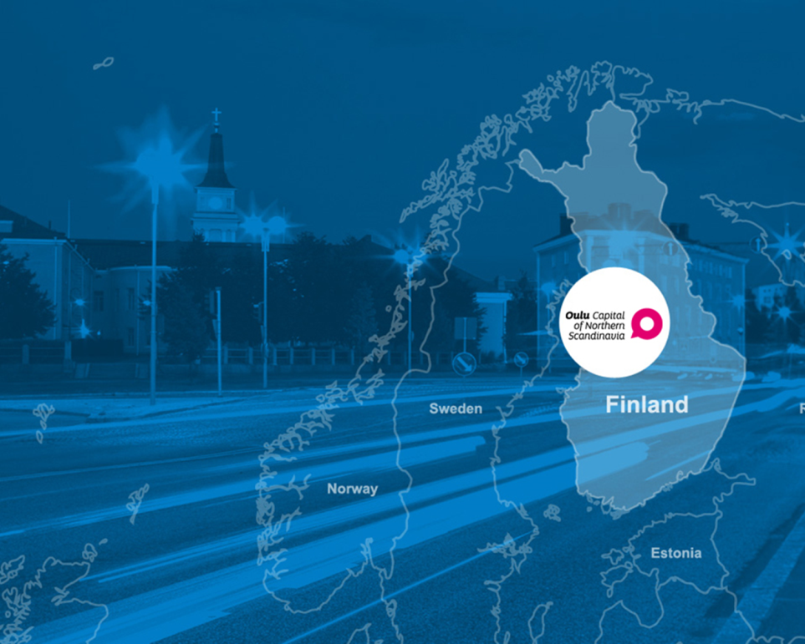
Oulu, City of 240 000 people
+400 ICT companies
15 000 high-tech jobs
+7500 R&D experts
200 eHealth companies
400 start-up companies
16 000 students in University of Oulu
8000 students in Oulu University of Applied Sciences

Slide 3
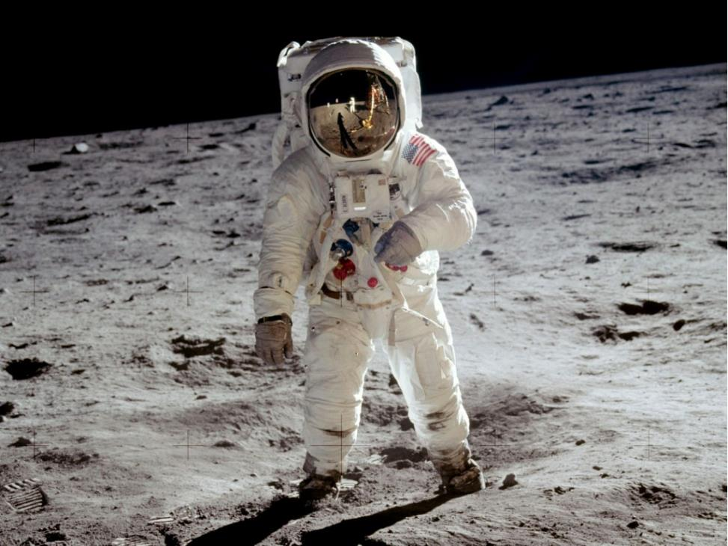
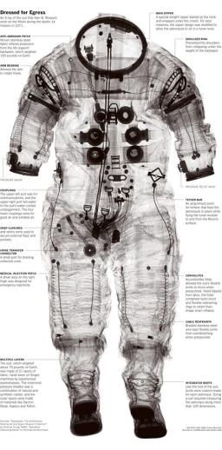
Grand Challenge USA

Slide 4
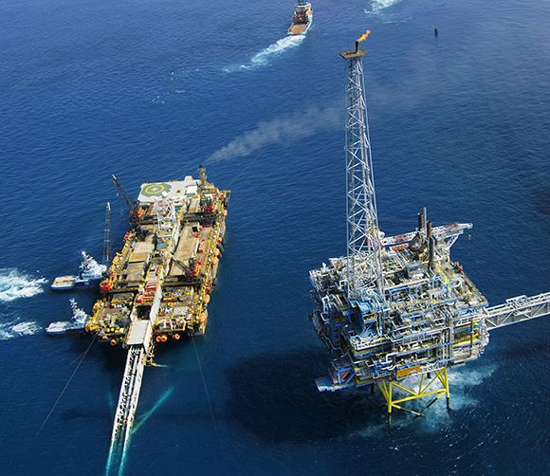
Grand Challenge Norway

Slide 5
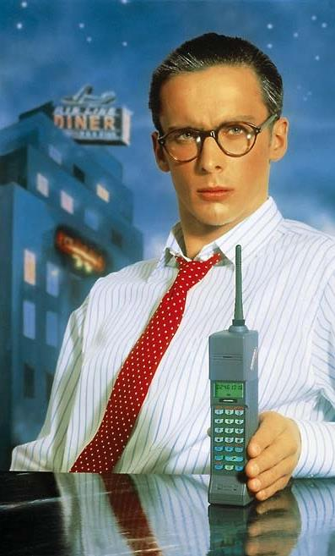
Grand Challenge Finland
Grand Challenge Finland

Slide 7
OULU

Slide 9
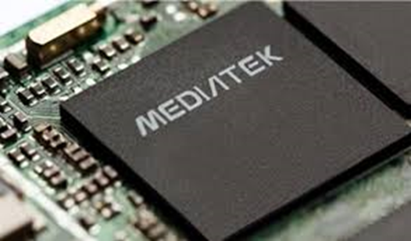
Investeringer siden 2014
Baidu invested to IndoorAtlas
Bitwise
Elektrobit AutoMotive
Eyelife
Kionix (Rohm)
Mediatek
Nordea
Nordic Semiconductor
Solita
Spreadtrum
Synopsus to Acquire Codenomicon
Wear IT
“Finland has long been recognized as the home of many experienced engineers well-versed in cellular technologies.
By opening our new office in Oulu, we hope to be an attractive employer to some of most seasoned engineers and the brightest graduating engineers from local universities”
JS Pan
Deputy General Manager
MediaTek’s Wireless Communications Technology business unit

Slide 10
Skape et økosystem gjennom samarbeid

Slide 11
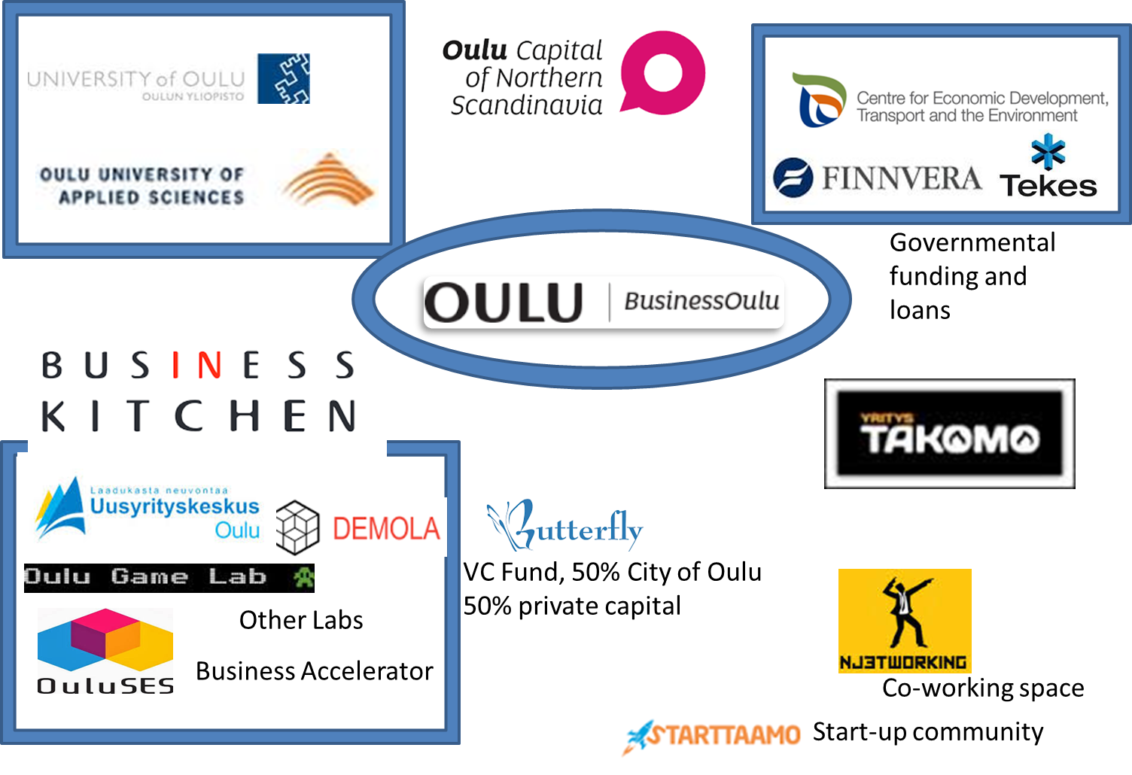

Slide 12
En generasjon av 400+ start ups siden 2012!

Slide 13
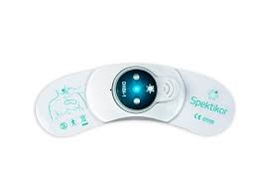
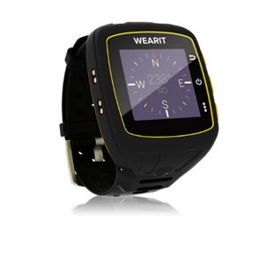
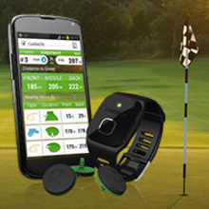
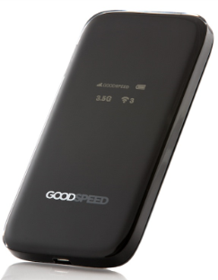
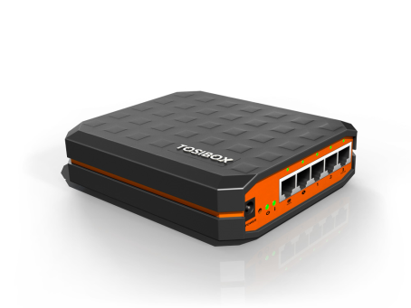
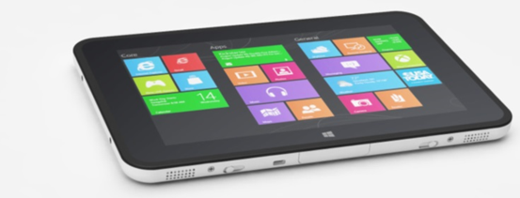
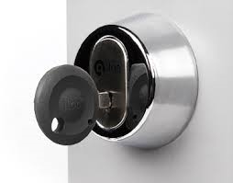
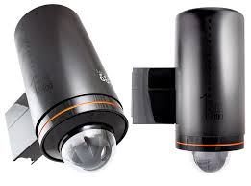
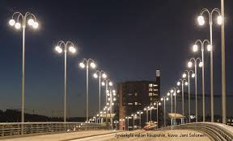
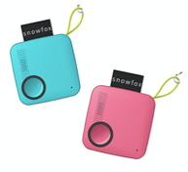
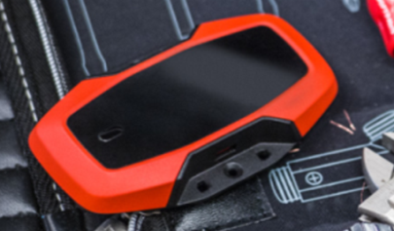
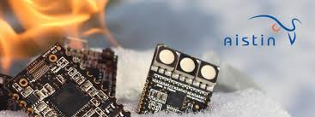
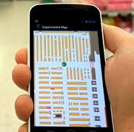
Examples of products designed in Oulu

Slide 14
R&D, Testing and Mass production skills
Wireless device creation based on customer requirements, HW and mechanical engineering simulated and realized into prototypes, integrated with selected SW design, giving birth to a mature certified solution for end users to enjoy
Device Requirements
Design and
Solution Options
Product Creation and Verification
Market Access , Sales and Service
1
2
3
4

Slide 15
Velkommen! Maja Terning, BusinessOulu maja.terning@businessoulu.com

